Slide 1

PrepU
Shrinika Mandava, Smera Kapoor, Philip Frangie, Jason Chen, Chengju Li

Slide 2
Business Concept
A meal prep service designed for college students with busy schedules, dietary restrictions or preferences, and restricted resources (dorm room, no kitchen, limited appliances)
Making it affordable so that it caters to college students, while also allowing them to be purchased with meal swipes/dining dollars to provide convenience for students that live in on campus.

Slide 3
Our mission is to provide college students with personalized, convenient, nutritious, and affordable meal options that fit their busy lifestyles and dietary needs. We aim to support student success by offering balanced meals that can be purchased using meal swipes, making healthy eating simple, stress-free, and fitting to individual tastes.
Customer Value Proposition

Slide 4
Convenient meals accessible to college students all over the world.
Student First: We prioritize student health, affordability, and convenience.
Accessibility: We strive to make nutritious meals available to all students, regardless of schedule or resources.
Quality: We provide fresh, balanced meals made with care.
Integrity: We operate honestly and responsibly in everything we do.
Community: We support our campus and local partners while creating a positive impact.
Vision
Providing quick, healthy, affordable meals for students in one click, without sacrificing taste.
Mission
Core
Values

Slide 5
Financial and Strategic Objectives
5
FINANCIAL
STRATEGIC
Achieve positive net cash flow by the end of the second year of operation.
Achieve a net profit margin of at least 12% by the end of the third full year of operation.
Reduce cost of production within the first 3-4 years of operations
Acquire at least 200 new student customers per semester during the first year of operation.
Achieve a customer retention rate of at least 60% by the end of the first full academic year.
Reach at least 35% of students that live in college apartments across new jersey colleges/universities through social media and ads

Slide 6

Corporate Social Responsibility Key Initiatives and Rationale
6
Our team has decided to Adopt CSR Culture and to implement CSR initiatives!
CSR Initiative
Rationale
Use sustainable suppliers
Ensure that the suppliers reduce greenhouse gas emissions and reduce air pollutants (pick specific warehouses)
Make sure the farmers/workers are all treated fairly and compensated we
Sustainable Packaging Initiative: Use recyclable or compostable meal containers and reduce single-use plastics
College students are environmentally conscious. This idea directly addresses their environmental concerns and reduces waste on campus.
Donating money or food to food banks/shelters
This business is very heavily food based, and catered to students who need more affordability in healthy food, it would have a good social impact if there are food donations for the less fortunate

Slide 7

New Products and Services
7
Our new product is a High-Protein Fitness Meal Line
These are pre-made meals focused on students who work out or play sports.
Higher protein portions sold at a slightly higher price point.

Slide 8

8
National Expansion
Decision
Yes, we will nationally expand, but only after we establish our brand.
Approach
The approach we would go with is franchising
Rationale
National expansion would give us multiple revenue streams and extend our reach. We chose franchising because it enables faster growth with less capital required, reduces our financial risk, and empowers owners who truly understand their local campus communities. It would give us control over who runs the stores and let us access local business owners who know their communities well.

Slide 9

We decided to globally expand into Canada.
Global Expansion
Opportunities
Similar Culture to the U.S
Large College Population
Strong Economy
Easy market entry
Challenges
Higher operating Cost
Different Food Regulations
Different federal Regulations
Rationale
Similar Culture
Easy Entry
Good College Life

Slide 10
We decided to use a combo strategy and a joint entry strategy.
Expansion & Entry Strategy
Custom
Better fit for the locals
Higher customer satisfaction
Joint
Allows us to partner with local companies
Gives us a head start in learning new culture and regulations
Maintain control over our brand and operations

Slide 11
11
Key Job - Nutritionist
Responsibilities - Create meal plans and provide nutrition details for all foods
Qualifications - Degree in nutrition and have previous experience in food
Compensation Plan - $75k salary and paid time off
Advertising Plan - For this job we will be recruiting from Linkedin, Indeed and through Rutgers
Criteria - Relevant internship or professional experience in nutrition

Slide 12

Employee Motivation
12
Motivation Initiatives
Provide free daycare for employees with young children
PTO for top performers
End of the year bonuses if the team hits a certain goal
Create a professional development fund for courses, certifications, and conferences.
Provide health related resources (mental health, volunteer opportunities, health insurance)
Employee motivation is very important. Having a good work life balance encourages the employee to work harder and also help the people around them.

Slide 13
Hello Everyone,
I’m writing to share that Employee 1 and Employee 2 will be moving on from PrepU, with their last day being today.
Both have been valued members of our team, and we are grateful for their hard work and the impact they’ve made during their time here. We wish them nothing but the best in their next chapters.
Losing talented colleagues is always a moment for reflection. We recognize that for us to grow as a company, we must also grow as an employer. We’ve heard your feedback and are committed to making PrepU a place where everyone feels supported and empowered to stay long-term.
Best Regards,
PrepU Management
Employee Departure Announcement

Slide 14
Employee Engagement Initiatives
Providing free daycare (for employees with young children)
Provide health related resources (mental health, volunteer opportunities, insurance)
Encourage employees to use all offered paid time off every year
Create a professional development fund for courses, certifications, and conferences.
End of the year bonuses if the team hits a certain goal

Slide 15
SIPOC
SUPPLIERS
INPUTS
PROCESS
OUTPUTS
CUSTOMERS
Warehouse Provider
Office Building/Real Estate
Labor Market
Retail Stores
Fresh Ingredients
Meal Recipes & Nutritional Guidelines
Meal Containers & Packaging
Student Orders
Meal Swipe Authorization
Create meal kit options
Find a space for manufacturing
Buy all necessary ingredients and supplies
Prepare all meal kits as needed
Deliver
Fast shipping
Good taste and flavors
Efficient customer service
Affordability
Who:
College Students
Desired Customer Behaviors:
Returning Customers
Recommended through word of mouth
Good reviews
Customer Requirements:
High quality
healthy and delicious meals

Slide 16
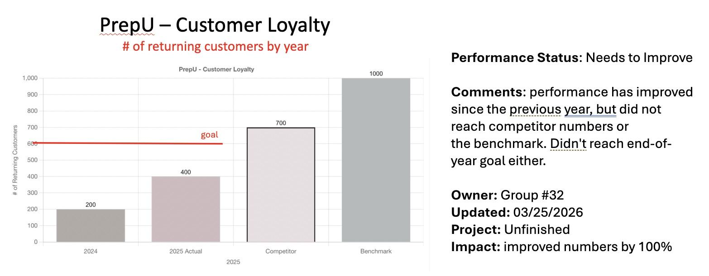
Performance Measurement
EFFECTIVENESS MEASURES

Slide 17
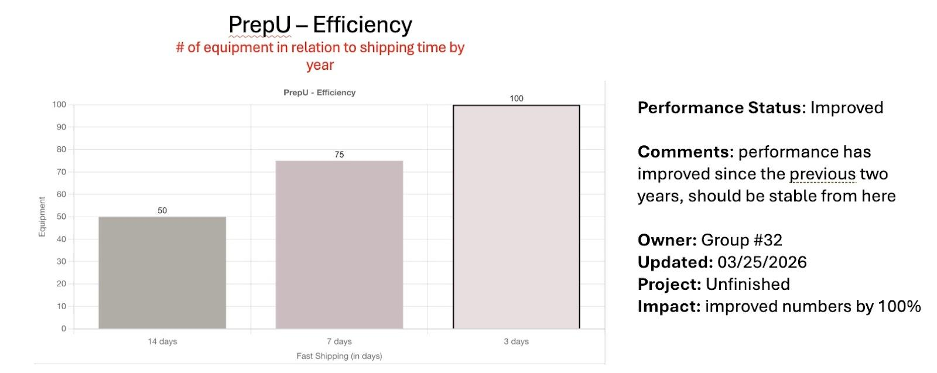
Performance Measurement
EFFICIENCY MEASURES

Slide 18
Focus Area
Improvement Initiative
Process Improvement Initiative
Expand Menu Variety
Effectiveness
(Customer Retention Rate)
Offer weekly and bi-weekly subscription packages allowing students to customize frequency and meal types
Flexible Subscriptions
Offer weekly and bi-weekly subscription packages allowing students to customize frequency and meal types
Current:
50% retention rate
Customer Feedback System
Collect weekly post-delivery ratings and use data to adjust menu offerings each semester
Target:
65% within 6 months
Engagement-Driven Service
Apply employee engagement strategies to improve service quality, as better staff experience leads to better customer experience

Slide 19
We decided not to sell as while the offer would provide financial gains, our responsibility to employees, partners, and our mission outweighs short-term personal wealth.
Decision on Selling the Business
Stakeholder Impact
Buyer Inexperience
Sale would eliminate jobs for current HQ employees with no guaranteed retention by buyers who lack experience in this business
The buyers inherited their wealth and have no experience managing this type of business, long-term success is very doubtful
Mission Alignment
Responsible Growth
PrepU was built to serve students. New ownership moving HQ abroad and restructuring operations threatens that core mission
Our leadership team can continue building the business responsibly while protecting employees, partners, and CSR initiatives

Slide 20
Why PrepU Has Been Successful
Clear Mission & Values
Smart, Responsible Growth
Customer-Driven Innovation
From Day 1, PrepU's purpose was student-centered. Every decision (pricing, CSR, expansion) reflects our mission.
Franchised nationally, entered Canada via joint venture. Expanded in a controlled way that preserved quality and brand.
Listened to students: added high protein meals, flexible subscriptions, and adapted menus based on real feedback.
Strong People Culture
Performance Management
Ethical Leadership
Invested in employee motivation and engagement, creating a team that goes above and beyond because they believe in the mission.
Mapped key processes, measured what matters, and launched improvement initiatives, always pursuing better results.
Declined unethical payments, adopted CSR, and chose not to sell the company for profit when it conflicted with our values.

